Slide 1
SWE 4101
Networking & Internet
Lec - 6
Based on: Books and various web resources…

Slide 2

Basic Element of Communication system

Slide 3
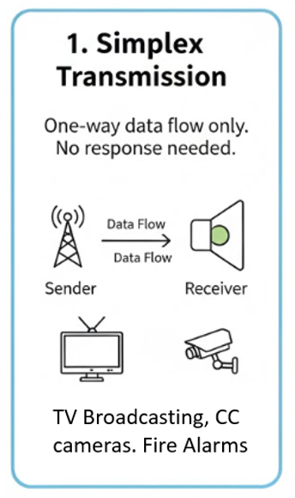
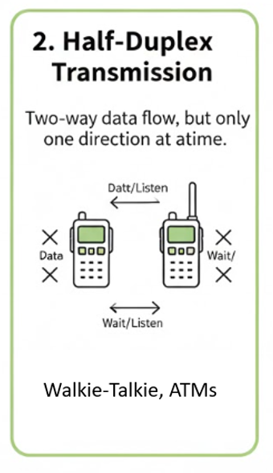
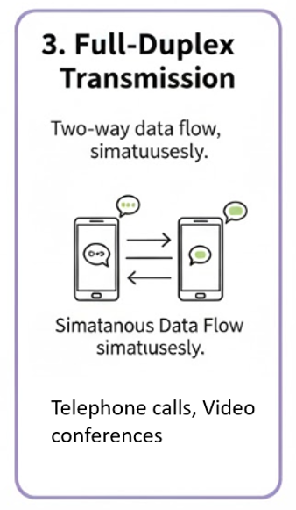
Data Transmission Modes
Based on the direction of data flow

Slide 4
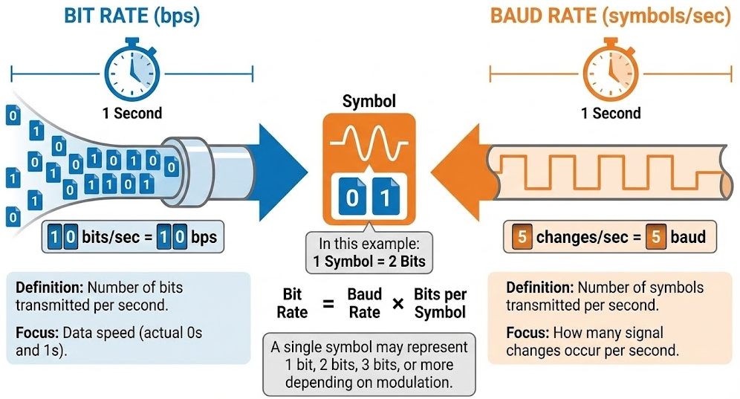
Trasmission Rate

Slide 5
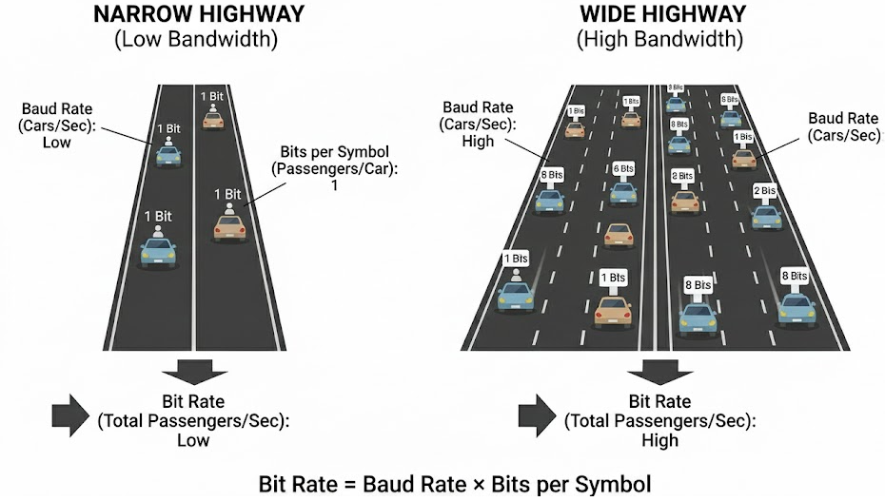
Trasmission Rate
Bandwidth represents the capacity of the channel (measured in Hertz). Think of it as the width of a highway.
Transmission Rate (or Bit Rate) represents the speed of data flow (measured in bits per second).
Transmission rate depends mostly on Bandwidth

Slide 6
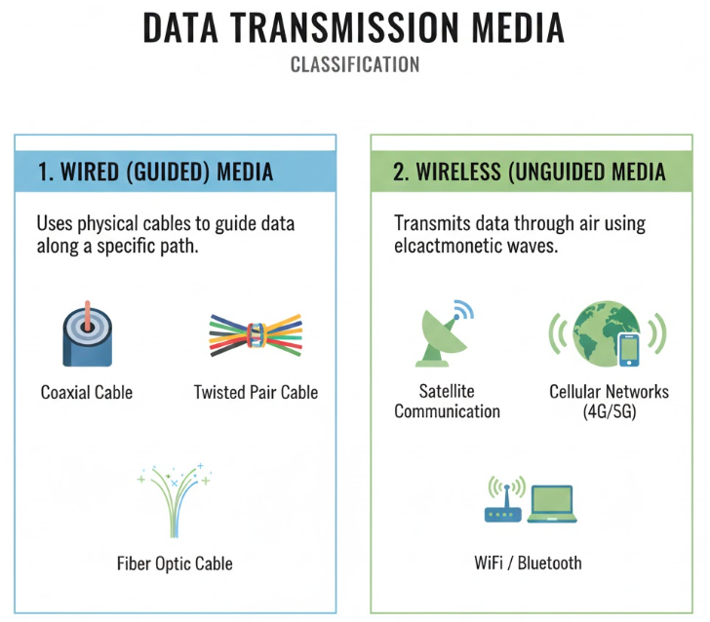
Transmission Medium

Slide 7


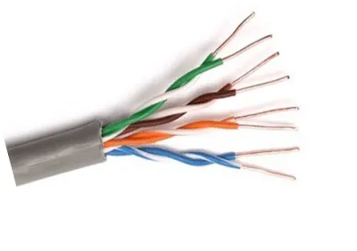
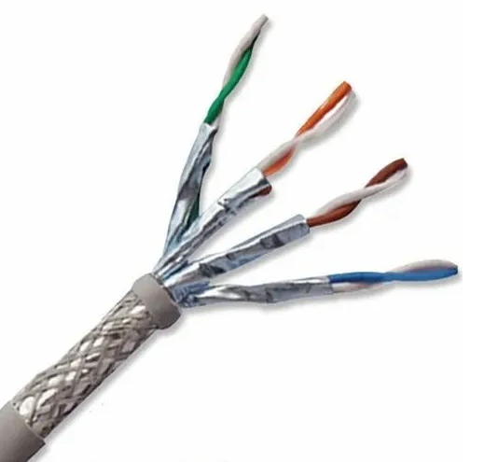
Transmission Medium : Wired
Twisted Pair Cable
  Most common networking cable
  Two copper wires twisted together
  Used in telephone lines, LANs (Ethernet)
  Two types:

Slide 8
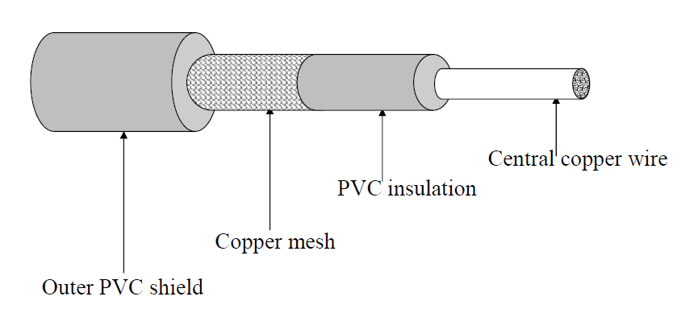
Transmission Medium : Wired
Coaxial Cable
  A central copper conductor with layers of insulation and shielding
  Better noise immunity than twisted pair
  Used in cable TV, broadband internet, CCTV systems

Slide 9
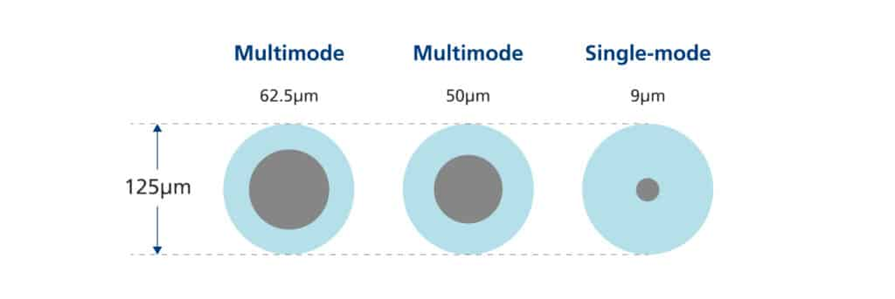
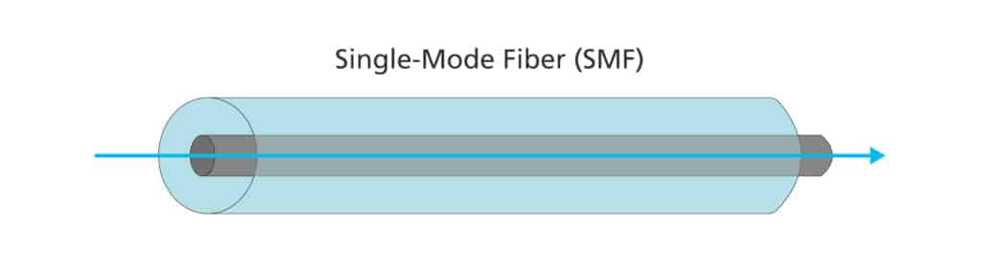
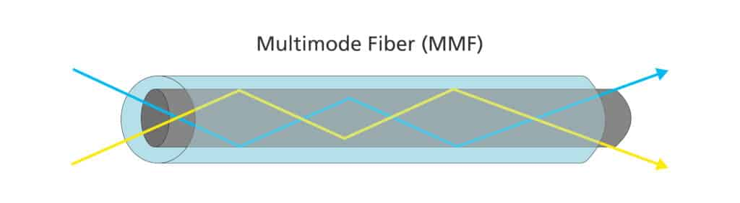
Transmission Medium : Wired
Fiber Optic Cable
  Transmits data as light pulses
  Very high speed and long-distance capability
  Immune to electromagnetic interference
  Types:
    Single-mode fiber (SMF) - send light along one pathway
    Multimode fiber (MMF) - allowing multiple light paths in the same cable
Feature | Single-Mode Fiber (SMF) | Multimode Fiber (MMF)
Core size (µm) | 9 µm | 50 µm or 62.5 µm
Number of modes (light paths) | 1 | 1000+
Optimal use | Long-distance communication | Short-distance communication
Distance capability | 40 km or more | 550 m at 1 Gbps300 m at 10 Gbps
Bandwidth | 100 Gbps and beyond | 10 Gbps – 400 Gbps (OM1–OM5)

Slide 10
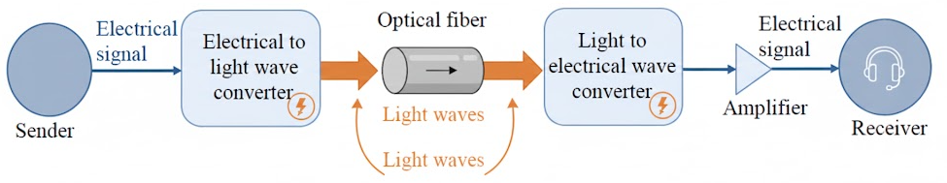
Transmission Medium : Wired
Optical fiber communication system

Slide 11
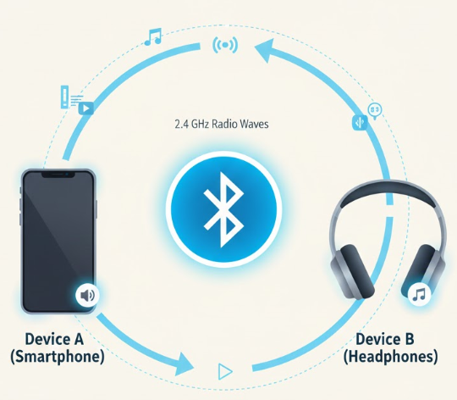
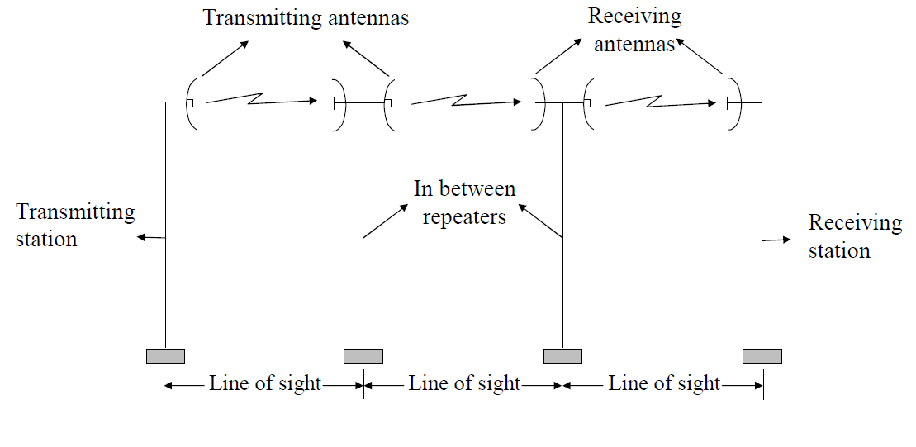
Transmission Medium: wireless
Radio Waves
  Used for long-distance communication
  Can penetrate walls
  Examples:
    FM/AM radio
    Wi-Fi
    Bluetooth
    Mobile networks (2G–5G)
Microwaves
  High-frequency, line-of-sight communication
  Used for point-to-point links
  Examples:
    Microwave towers
    WiMAX

Slide 12
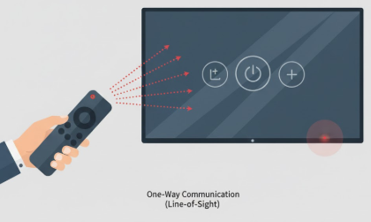
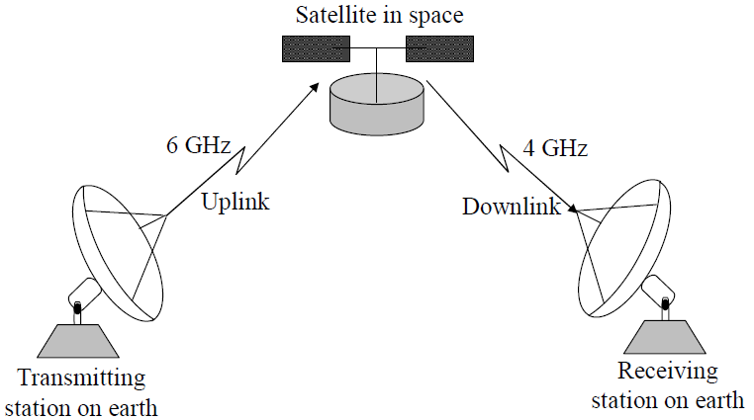
Transmission Medium: wireless
Infrared Waves
  Short-range communication
  Cannot pass through walls
  Examples:
    TV remote control
    Short-range data transfer devices
Satellite Communication
  Uses communication satellites orbiting Earth
  Supports global communication
  Used in TV broadcasting, GPS, weather monitoring

Slide 13
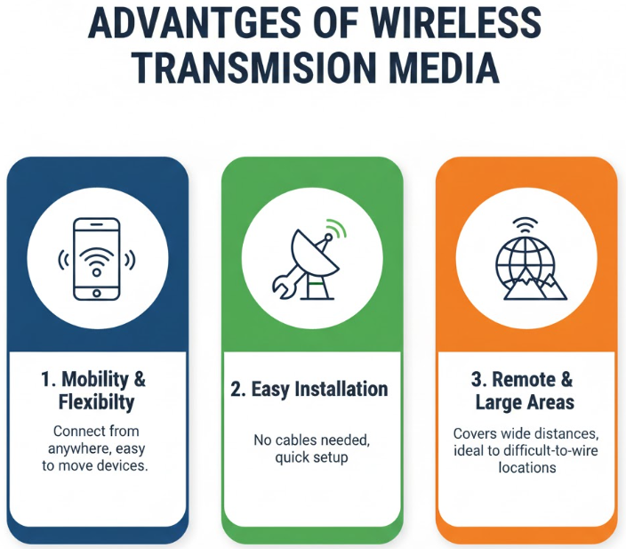
Transmission Medium : Wireless

Slide 14
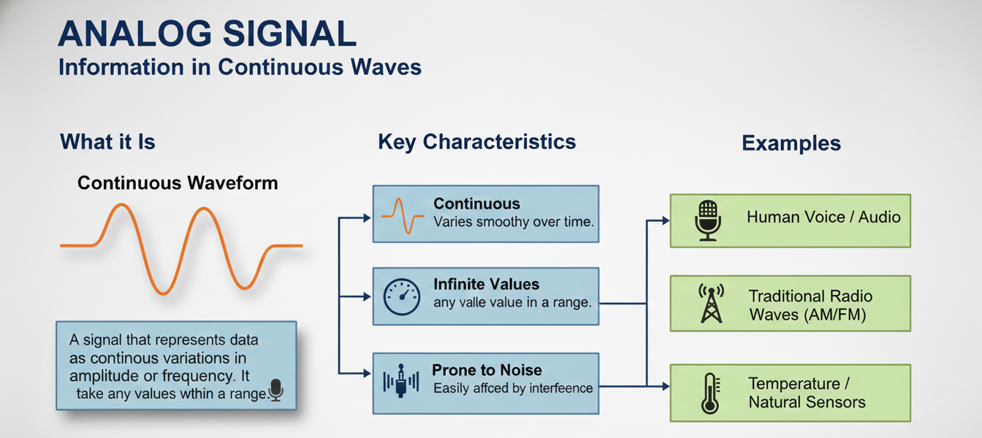
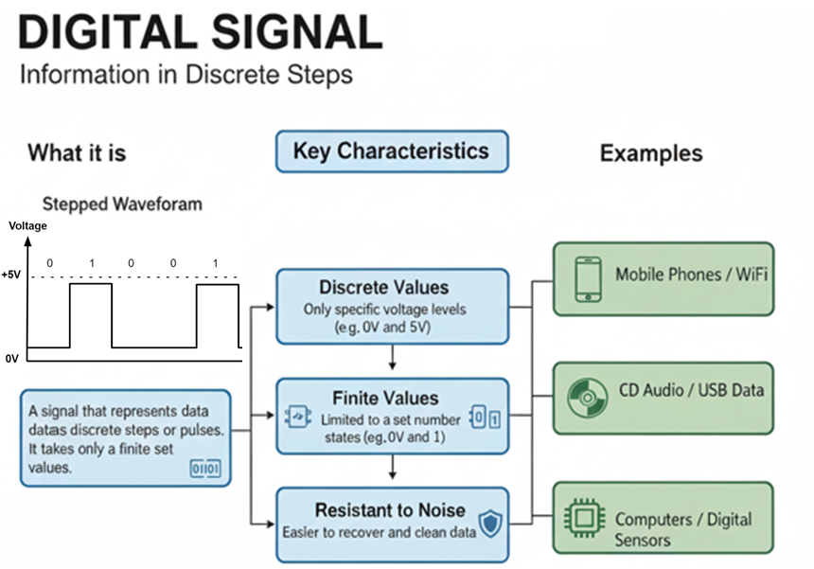
Transmission Types
Two main types of transmission based on the type of signal used:
  Analog Transmission
  Digital Transmission

Slide 15
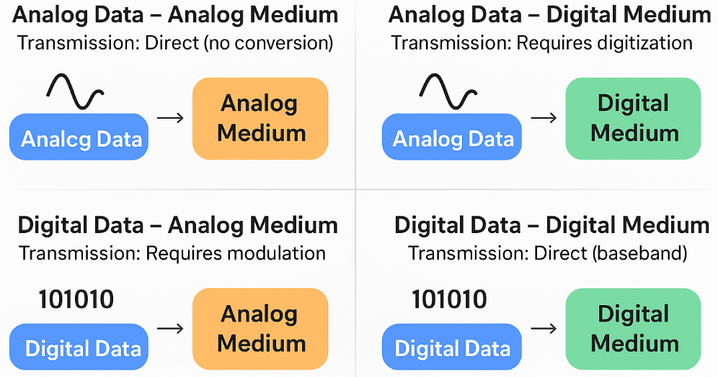
Transmission Types
Bridging Analog and Digital Domain
Four Possibilities

Slide 16
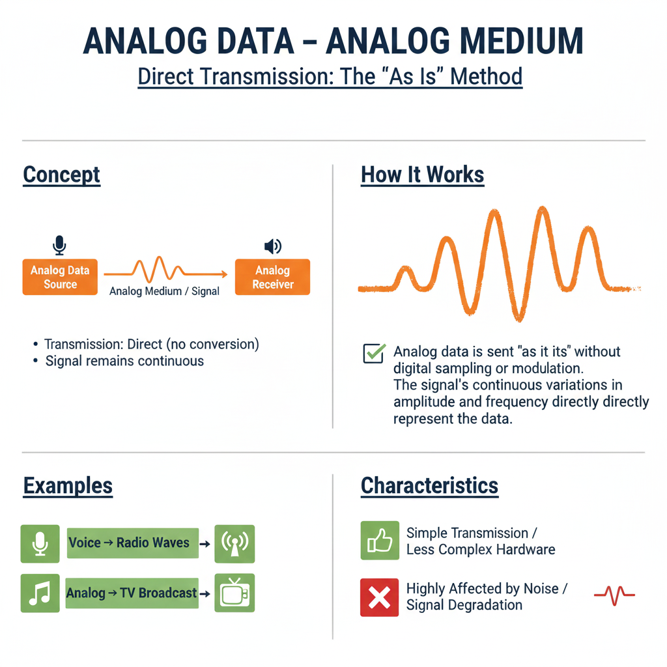
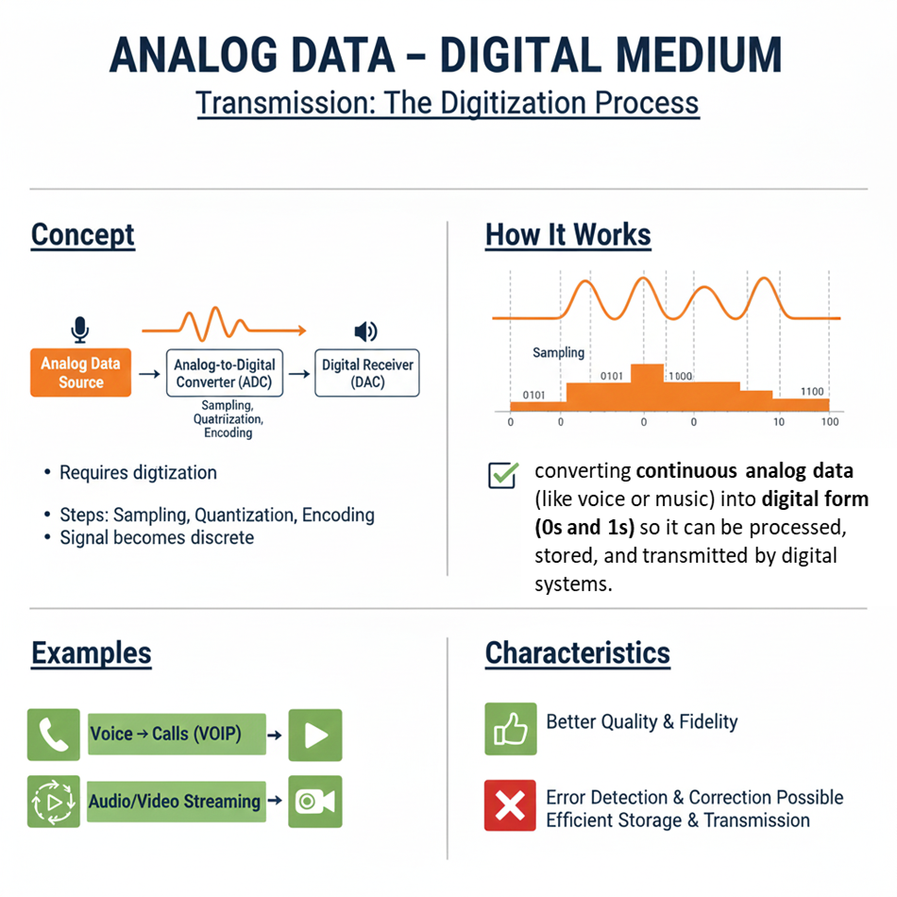
Transmission Types
analog modulation is required

Slide 17
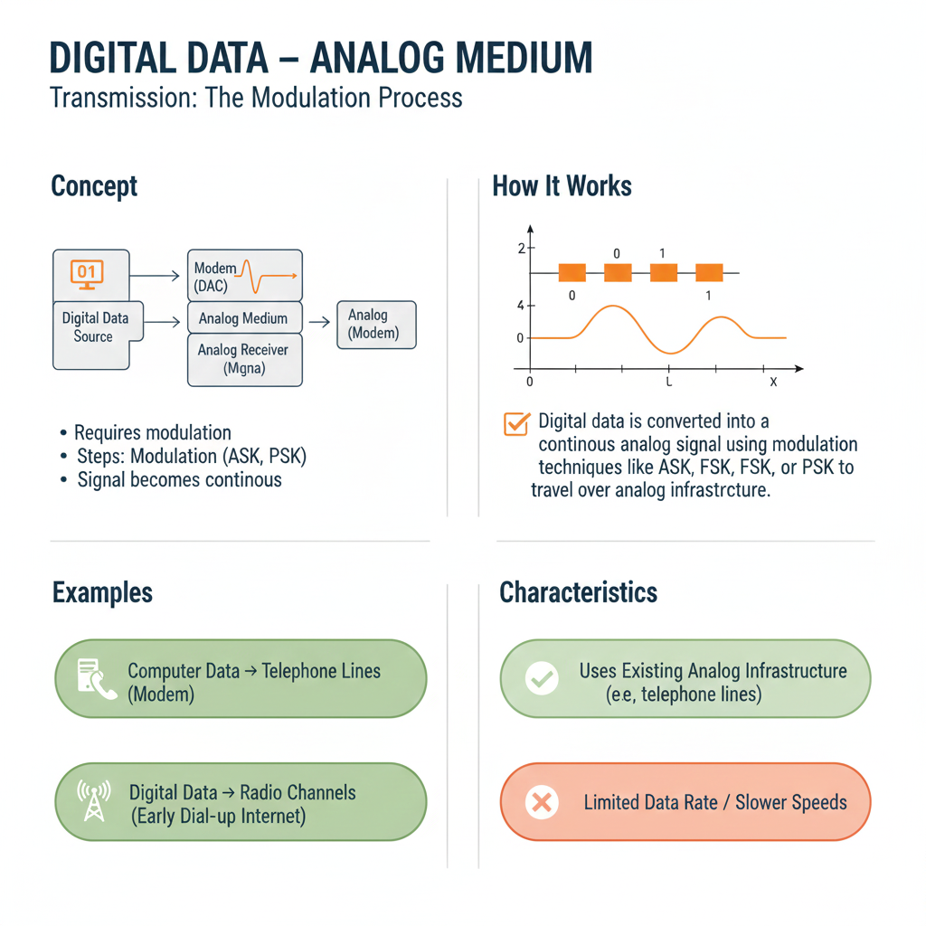
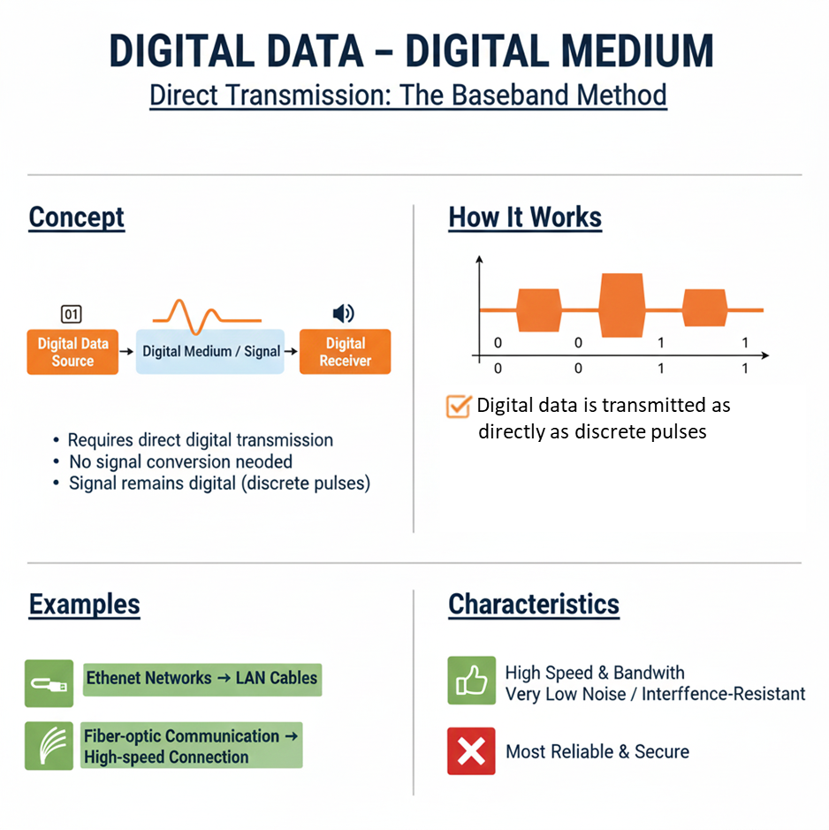
Transmission Types

Slide 18
Transmission Types
  Analog Data – Digital Medium
Analog to Digital Conversion (ADC) is the process of converting continuous analog data (like voice or music) into digital form (0s and 1s) so it can be processed, stored, and transmitted by digital systems.
Pulse Code Modulation (PCM) is the most widely used and foundational Analog-to-Digital Conversion (ADC) technique in digital audio and telecommunications.
Why ADC Is Needed
  Computers work with digital data
  Digital transmission is more reliable
  Supports compression, encryption, and error control
  Example: Human voice → microphone → digital audio file

Slide 19

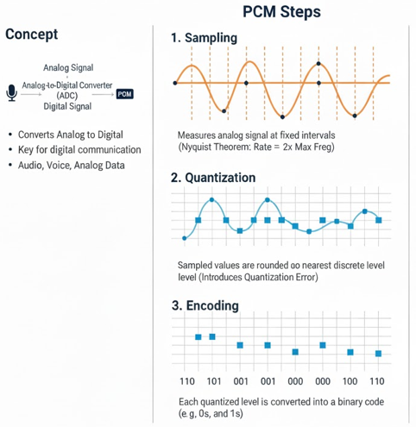
Transmission Types
  Analog Data – Digital Medium
The sampling rate must be at least twice the maximum frequency of the analog signal to avoid losing information.Example: For audio (20 kHz max), sampling rate ≥ 40 kHz.
Quantization rounds each sampled value to the nearest discrete level, introducing a small error called quantization error.

Slide 20
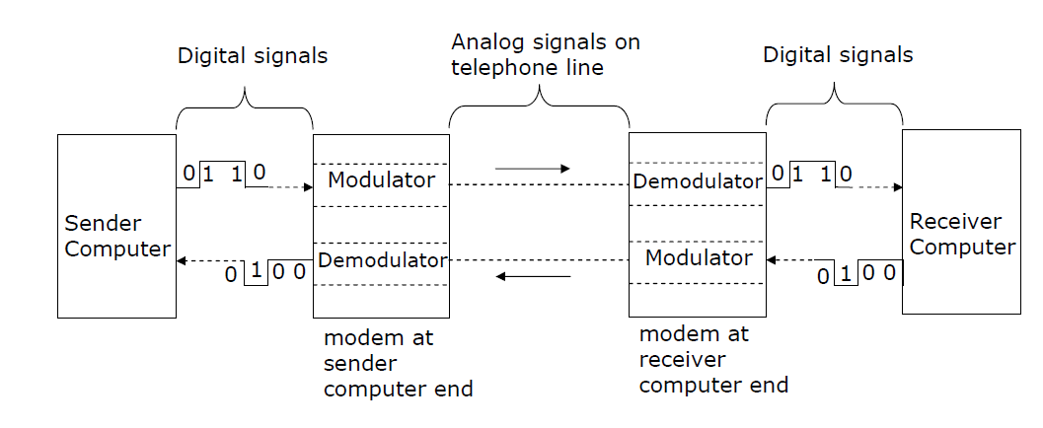
Transmission Types
  Digital Data – Analog Medium
When digital data is to be sent over an analog facility, digital signals must be converted to analog form
Conversion of digital signal to analog form is known as modulation
Conversion of analog signal to digital form is known as demodulation
Digital transmission of data is preferred over analog transmission of data due to lower cost, higher transmission speeds, and lower error rate

Slide 21
Transmission Types
  Digital Data – Analog Medium
Modem is short for MOdulator/DEModulator
Special device used for conversion of digital data to analog form (modulation) and vice-versa (demodulation)
Essential piece of hardware where two digital devices (say two computers) want to communicate over an analog transmission channel (say a telephone line)
Modulation is classified into analog modulation and digital modulation based on the nature of the input data.

Slide 22
Modulation
modulation is the process of modifying a signal (like your voice, music, or computer data) so that it can be transmitted over a long distance.
The Data: This is your original information (called the Baseband signal). It usually has a low frequency and lacks the energy to travel far on its own.
The Carrier: This is a high-frequency signal (usually a sine wave) generated specifically to carry the data. It travels through air or cables very efficiently.
Analog Modulation
Analog data → Analog signal
  Information is continuous
  Used in traditional communication systems
Types
  AM – Amplitude Modulation
  FM – Frequency Modulation
  PM – Phase Modulation
Example
  Radio broadcasting
  Analog TV
Digital Modulation
Digital data → Analog signal
  Information is discrete (0s and 1s)
  Used in data communication
Types
  ASK – Amplitude Shift Keying
  FSK – Frequency Shift Keying
  PSK – Phase Shift Keying
  QAM – Quadrature Amplitude Modulation
Example
  Radio broadcasting
  Analog TV

Slide 23
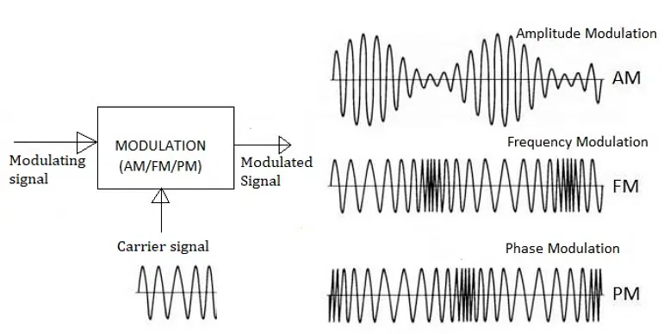
Modulation
Three pieces of information to manipulate: amplitude, frequency, and phase.
  Amplitude modulation (AM): encode bits using amplitude levels.
  Frequency modulation (FM): encode bits using frequency differences.
  Phase modulation (PM): encode bits using phase shifts.

Slide 24
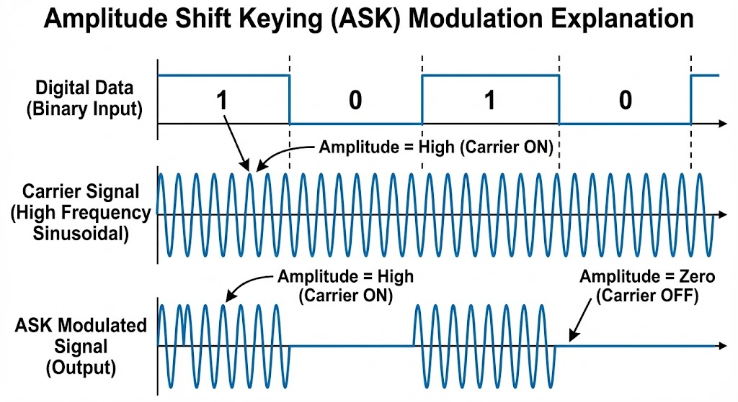
Modulation

Slide 25
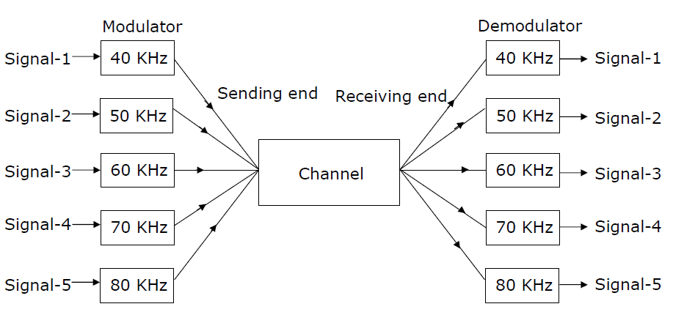
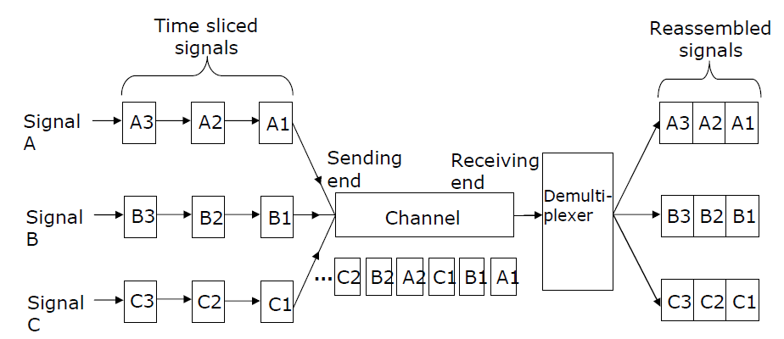
Multiplexing
Method of dividing physical channel into many logical channels so that a number of independent signals may be simultaneously transmitted
An electronic device that performs multiplexing is known as a multiplexer
Multiplexing enables a single transmission medium to concurrently transmit data between several transmitters and receivers
Frequency-Division Multiplexing (FDM)
Time-Division Multiplexing (TDM)

Slide 26
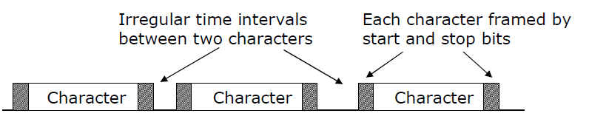
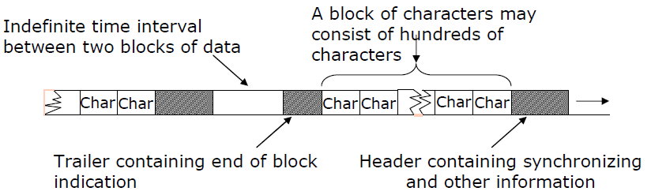
Asynchronous vs Synchronous Transmission
Asynchronous Transmission In this method, data is sent one "character" or byte at a time.
Start and Stop Bits: Each character is "framed" by a start bit and a stop bit. This tells the receiver exactly when a new character begins and ends.
Irregular Gaps: There can be uneven time intervals between the characters. The system doesn't need to stay perfectly synced during these idle periods.
Synchronous Transmission
  Data Blocks: Instead of single characters, characters are grouped into large blocks or frames.
  Headers and Trailers: Each block contains a header with synchronization information and a trailer to indicate the end of the block.
  Constant Timing: The sender and receiver must be perfectly synchronized by a shared clock signal to ensure the data is read correctly.

Slide 27
Switching Techniques
Data is often transmitted from source to destination through a network of intermediate nodes
Switching techniques deal with the methods of establishing communication links between the sender and receiver in a communication network
Commonly used switching techniques are:
    Circuit switching: A Dedicated physical path is established between sending and receiving stations through nodes of the network for the duration of communication.
    Packet switching: Message is split up into fixed size packets and each packet is transmitted independently from source to the destination node. Either store-and forward or broadcast method is used for transmitting the packets. All the packets of a message are reassembled into original message at the destination node

Slide 28
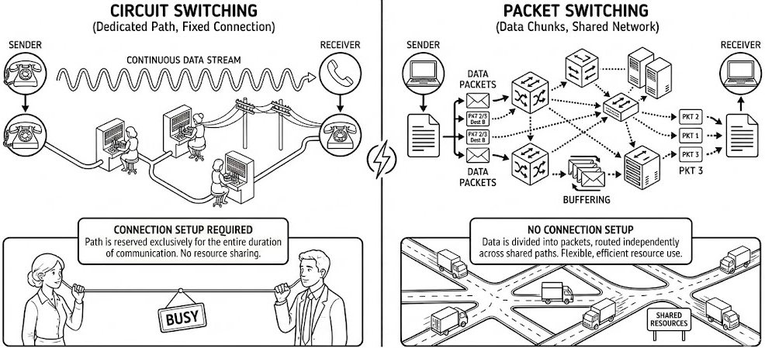
Switching Techniques

Slide 29
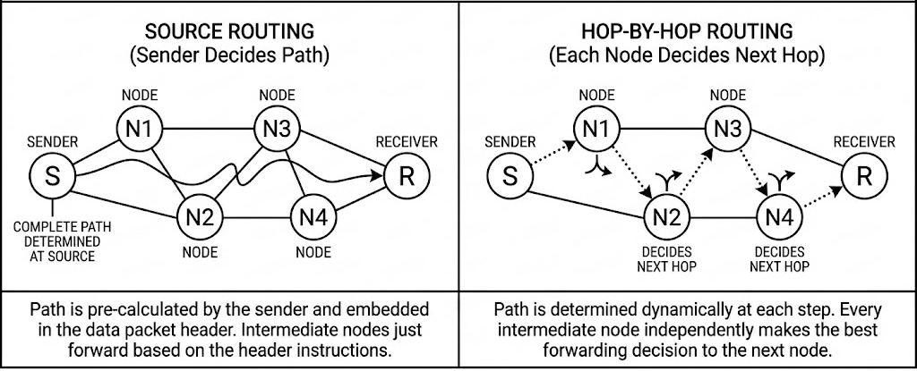
Routing Techniques
In a WAN, when multiple paths exist between the source and destination nodes of a packet, any one of the paths may be used to transfer the packet
Selection of path to be used for transmitting a packet is determined by the routing technique used
Two popularly used routing algorithms are:
  Source routing: Source node selects the entire path before sending the packet
  Hop-by-hop routing: Each node along the path decides only the next node for the path

Slide 30
Network Topology
Networks consist of a series of interconnected nodes and links.
Nodes include devices such as routers, switches, repeaters, and computers.
Network topology refers to the physical and logical arrangement of nodes and connections in a computer network, which governs how data flows between devices.
The physical topology outlines how devices are physically connected, while the logical topology focuses on how data moves through the network.
Why Important:
  Impact on network performance
  Network reliability and fault tolerance
  Scalability and flexibility
  Cost considerations
  Ease of management and troubleshooting
Components of network topologies
  Nodes - A node is a point of connection in a network that can send and receive data. Nodes include both physical devices and communication equipment
  Links - Links are the transmission media that are used to send information between the nodes in a network. They can be wired or wireless

Slide 31
Network Topology
Point-to-point topology
contains exactly two hosts such as computer, switches or routers, servers connected back to back using a single piece of cable.
Bus topology
In a bus topology, all nodes are connected to a single cable—known as the bus or backbone.
This topology is cost-effective and easy to implement
but it has limitations, such as a single point of failure; if the backbone fails, the entire network goes down.
Bus networks are also less secure due to the shared backbone.
Ring topology
each host machine connects to exactly two other machines, creating a circular network structure.
Data flows in one direction around the ring, though dual-ring systems can send data in both directions.
These networks are generally cheap to install and expand and data flows quickly within the network.
The main vulnerability of ring networks is that a failure of a single node can bring down the whole network.

Slide 32
Network Topology
Star topology
all the nodes are connected to a central hub.
The nodes are positioned around that central hub in a shape that roughly resembles a star.
If a single node fails, the rest of the network is unaffected, as long as the central hub is operational.
Tree topology
Tree topology combines elements of both bus and star networks, creating a hierarchical structure.
In this configuration, a central hub serves as the root node, connecting to multiple star networks rather than individual nodes.
This architecture enables a higher number of devices to connect to a central data center, enhancing data flow efficiency.
network nodes depend on a central hub, creating dependencies that can affect network performance.
The single point of failure at the central hub can disrupt the entire network.

Slide 33
Network Topology
Mesh topology
A mesh topology is a highly interconnected network structure where each node is directly linked to multiple other nodes.
In a full mesh configuration, every node connects to every other node within a single network, creating redundant paths for data transmission.
This high level of interconnectivity enhances network resilience and fault tolerance, as data can reroute through alternative paths if a connection fails.
The decentralized structure of mesh networks reduces reliance on a single point of failure, enhancing both security and efficiency.
Mesh networks provide several advantages such as improved data transmission speeds and scalability.
Hybrid topology
A hybrid topology combines elements of different topologies to meet specific needs.
A tree network that combines a star network and a bus network is also an example of hybrid topology.
Each hybrid network topology can be customized to build an efficient network architecture based on specific use cases and business needs.
However, creating a customized network architecture can be challenging and can require more cabling and network devices, raising maintenance costs.

Slide 34

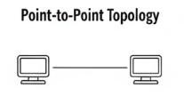

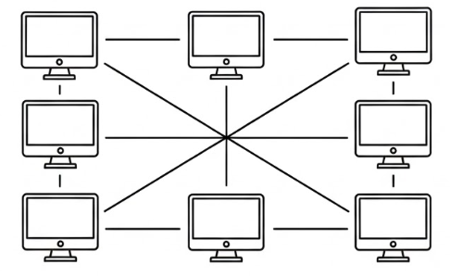



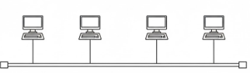



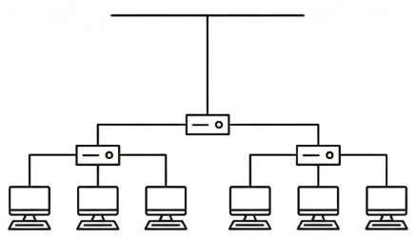
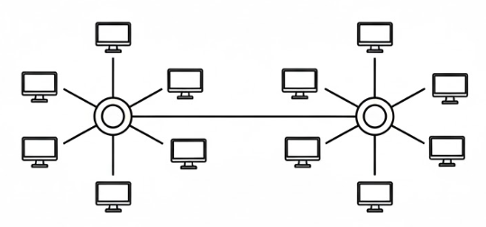
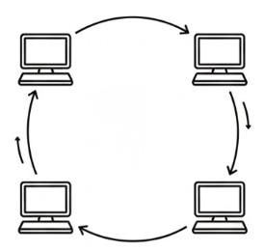
Network Topology

Slide 35
Network Types
Networks are broadly classified into two types: Local Area Network (LAN) and Wide Area Network (WAN)
Local Area Network (LAN) as compared to WAN:
  Limited to a small geographic coverage
  Has much higher data transmission rate
  Experiences fewer data transmission errors
  Has lower data communication cost
  Typically owned by a single organization
A MAN (Metropolitan Area Network) covers a city or metropolitan area, which is larger than a LAN but smaller than a WAN.

Slide 36
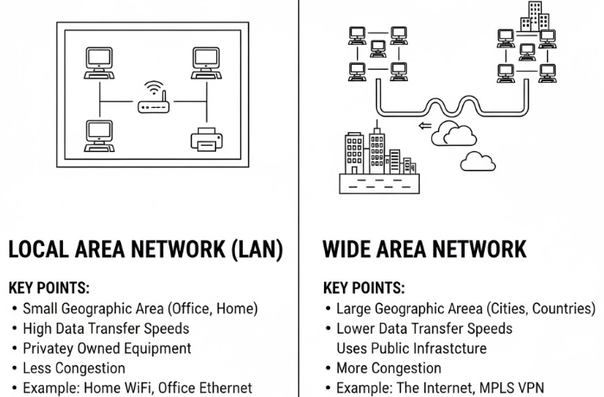
LAN vs WAN

Slide 37
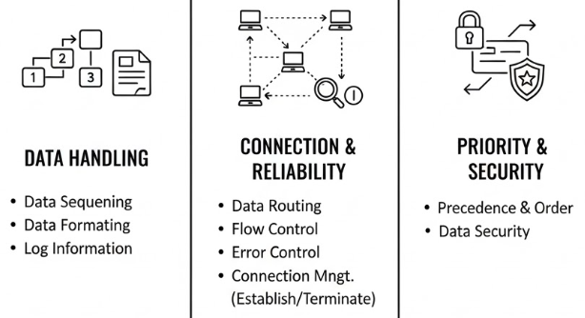
Communication Protocol
Protocol is a set of formal operating rules, procedures, or conventions that govern a given process
A communication protocol describes rules that govern the transmission of data over communication networks
Roles of communication protocol:

Slide 38
The OSI Model
The Open System Interconnection (OSI) model is framework for defining standards for linking heterogeneous computers in a packet switched network
Standardized OSI protocol makes it possible for any two heterogeneous computer systems, located anywhere in the world, to easily communicate with each other
Separate set of protocols is defined for each layer in its seven-layer architecture. Each layer has an independent function

Slide 39
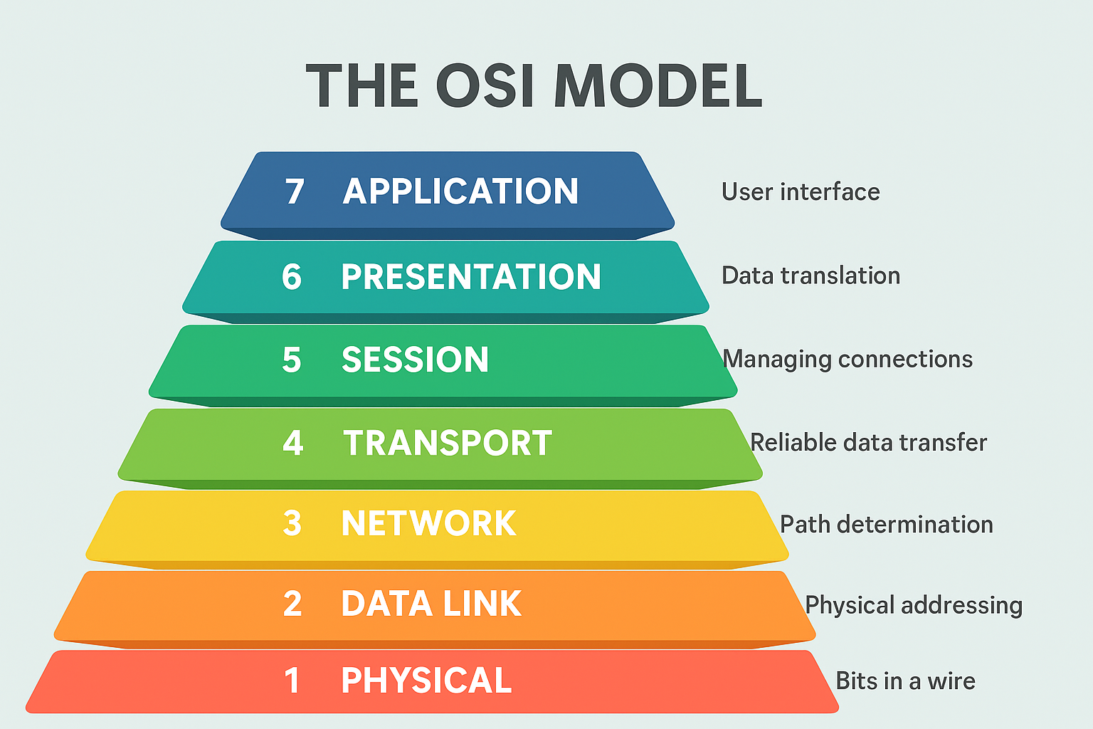
The OSI Model
All People Seem To Need Data Processing

Slide 40
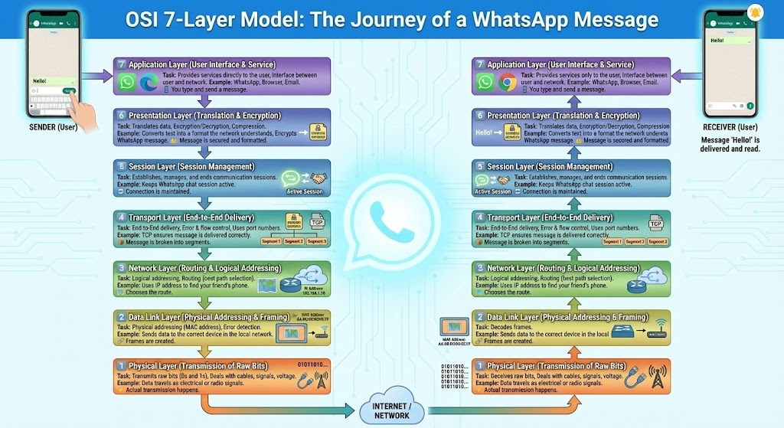
The OSI Model

Slide 41
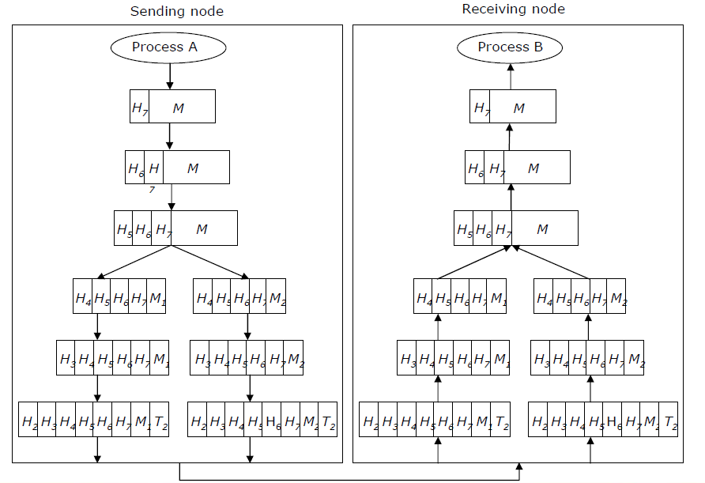
The OSI Model: Sending Msg…

Slide 42
Internetworking
Interconnecting two or more networks to form a single network is called internetworking, and the resulting network is called an internetwork
Goal of internetworking is to hide details of different physical networks, so that resulting internetwork functions as a single coordinated unit
Tools such as bridges, routers, routers, and gateways are used for internetworking
The Internet is the best example of an internetwork

Slide 43
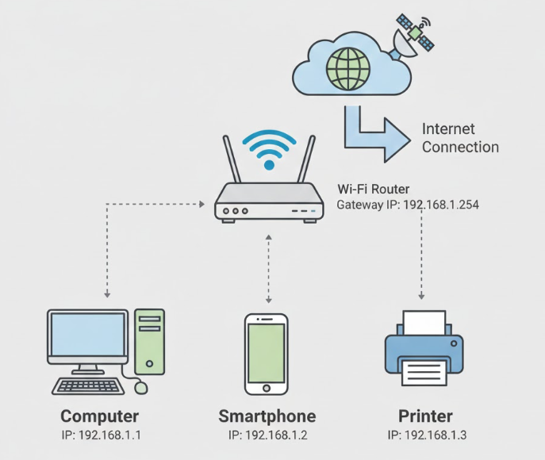
IP Address
An IP Address (Internet Protocol Address) is a unique number assigned to every device connected to a network. It helps devices communicate with each other.
A unique 32-bit number
Identifies an interface (on a host, on a router, …)
Represented in dotted-quad notation
12
34
158
5
00001100
00100010
10011110
00000101

Slide 44
IP Address
Types of IP Address (Based on Protocol Version)
  IPv4 (Internet Protocol version 4)
    32-bit address (e.g., 192.168.1.1)
    Most common, but limited in numbers.
  IPv6 (Internet Protocol version 6)
    128-bit address (e.g., 2001:0db8::1)
    Solves IPv4 shortage, more devices can connect.
Types of IP Address (Based on Assignment Method)
  Static IP – Manually assigned, does not change.
  Dynamic IP – Automatically assigned by DHCP, can change over time.IPv6 (Internet Protocol version 6)
Types of IP Address (Based on Assignment Method)
  Public IP – Visible on the Internet, globally unique.
  Private IP – Used only inside local networks, not visible on the Internet (e.g., 192.168.x.x).

Slide 45
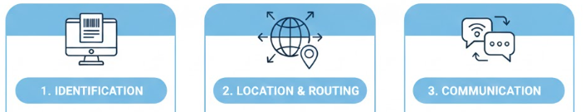
IP Address – Why Importatn
Unique ID for each device
Like a digital name for all
Help send data to the correct destination
Guide data packets across the internet
Allows devices to talk to others
Foundation of all network communication.

Slide 46
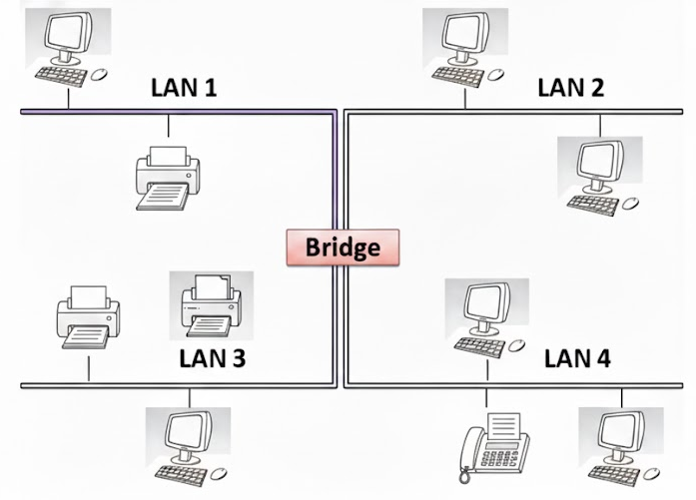
Bridges
Operate at the bottom two layers of the OSI model
Connect networks that use the same communication protocols above data-link layer but may use different protocols at physical and data-link layers
Connects two similar networks or network segments
Works with MAC (physical) addresses
Filters and forwards frames within a LAN
Example: Connecting two LAN segments in the same network

Slide 47
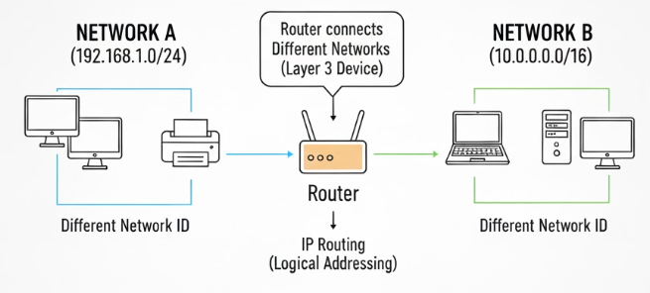
Router
Operates at the top three layers of the OSI model (session, presentation and application)
Used for interconnecting dissimilar networks that use different communication protocols
Connects different networks
Works with IP (logical) addresses
Finds the best path for data packets
Example: Connecting a home network to the Internet

Slide 48

Gateway
Operates at the top three layers of the OSI model (session, presentation and application)
Used for interconnecting dissimilar networks that use different communication protocols
Connects different networks using different protocols
Converts protocols (acts as a translator)
Works at multiple network layers
Example: Connecting an IPS/SPX network to a TCP/IP network

Slide 49

Bridge-Router-Gateway

Slide 50
Wireless Computing System
Wireless computing system uses wireless communication technologies for interconnecting computer systems
Enhances functionality of computing equipment by freeing communication from location constraints of wired computing systems
Wireless computing systems are of two types:
  Fixed wireless systems: Support little or no mobility of the computing equipment associated with the wireless network
  Mobile wireless systems: Support mobility of the computing equipment to access resources associated with the wireless network

Slide 51
Wireless Technologies
2G and 3G: Second- and third-generation mobile communication technologies that provide digital voice (2G) and both voice plus mobile data/internet services (3G).
Wireless LAN (WLAN): A local area network that uses wireless signals (Wi-Fi) to connect devices within a limited area like a home, office, or campus.
WiMAX: A long-range wireless broadband technology designed to provide high-speed Internet access over metropolitan areas.
Wireless Local Loop (WLL): A wireless system that connects subscribers to the public telephone network without using physical cables in the local loop.
Radio-router: A routing device that forwards data packets between networks using radio signals instead of wired links.
Multihop Wireless Network: A wireless network where data is transmitted across multiple intermediate wireless nodes to reach its destination.
Wireless Application Protocol (WAP): A protocol suite that enables mobile devices to access Internet content and services over wireless networks.

Slide 52

Firewall
Network traffic police
Tools that control the flow of traffic going between networks
By looking at addresses associated with traffic, firewalls determine whether connections should be transmitted or dropped

Slide 53


Slide 54

What is internet
The Internet is a network of computers that links many different computers all over the world
Network of networks sharing a common mechanism for addressing (identifying) computers, and a common set of communication protocols
Evolved from the basic ideas of ARPANET (the first WAN that had only four sites in 1969) for interconnecting computers
Initially used only by research organizations and universities to share and exchange information

Slide 55


Evolution of the Internet

Slide 56


Basic Services of the Internet

Slide 57
File Transfer Protocol (FTP)
FTP (File Transfer Protocol) is a standard network protocol used to transfer files between a client and a server over the Internet or a network.
It allows uploading, downloading, and managing files remotely.
FTP works on a client-server model:
  Server: Stores files and waits for requests.
  Client: Connects to the server to upload or download files.Uses TCP/IP for reliable data transfer.
Uses of FTP
  Sharing files between computers over the Internet.
  Uploading websites to web servers.
  Backup and retrieval of important documents.
  Collaborative work on shared projects.

Slide 58
client-server model
A client-server model is a network architecture where multiple clients (users’ devices) request services or resources from a central server.
The server provides the requested resources, processes the requests, and sends back responses.
Client:
  Any device or software that requests services from a server.
  Examples: Web browser, email client, FTP client.
  Role: Sends requests, receives responses, and interacts with the user.
Server:
  A powerful computer or program that stores resources, data, or services and responds to client requests.
  Examples: Web server, file server, email server.
  Role: Listens for client requests, processes them, and returns the results.
How It Works
  The client sends a request to the server (e.g., asking for a webpage or file).
  The server receives the request, processes it, and sends back the response.
  The client receives the response and presents it to the user.

Slide 59






client-server model

Slide 60

Telnet
TELNET is an abbreviation for TErminaL NETwork.
It is the standard TCP/IP protocol for virtual terminal service as proposed by ISO.
TELNET enables the establishment of a connection to a remote system in such a way that the local terminal appears to be a terminal at the remote system.
TELNET is a general-purpose
client-server application program.

Slide 61

Telnet
How Telnet Works:
  A user runs a Telnet client on their computer.
  The client connects to a Telnet server on the remote computer (usually on port 23).
  The user can send commands to the server and receive responses in real-time.

Slide 62
Telnet
Some common uses of telnet service are:
  Using the computing power of the remote computer
  Using a software on the remote computer
  Accessing remote computer’s database or archive
  Logging in to ones own computer from another computer
Advantages
  Simple to use for remote management.
  Works on almost all operating systems.
  Useful for network troubleshooting.
Disadvantages / Limitations
  Not secure: Sends all data, including passwords, in plain text.
  Vulnerable to eavesdropping and attacks over the Internet.
  Largely replaced by SSH (Secure Shell) for secure remote access.

Slide 63

SECURE SHELL (SSH)
Another popular remote login application program is Secure Shell (SSH). SSH, like TELNET, uses TCP as the underlying transport protocol.
is a network protocol that allows secure communication between two computers over an unsecured network.
SSH is more secure and provides more services than TELNET.
How SSH Works:
  The SSH client initiates a connection to the SSH server.
  Server sends its public key to the client.
  Client verifies the server’s identity.
  Once verified, both sides establish an encrypted session.
  User can now securely send commands or transfer files.

Slide 64

WWW or W3
Hypertext documents on the Internet are known as web pages
Web pages are created by using a special language called HyperText Markup Language (HTML)
WWW uses the client-server model and an Internet Protocol called HyperText Transport Protocol (HTTP) for interaction among the computers on the Internet
Any computer on the Internet that uses the HTTP protocol is called a web server and any computer that can access that server is called a web client

Slide 65

WWW or W3
It uses the concept of hypertext for information storage and retrieval on the Internet
Hypertext documents enable this by using a series of links
Link is a special type of item in a hypertext document that connects the document to another document providing more information about the linked item

Slide 66
WWW Browsers
WWW browser is a special software loaded on a web client computer that normally provides following navigation facilities to users:
  Does not require a user to remotely log in to a web server computer or to log out again when done
  Allows user to visit the server computer’s web site and to access information stored on it by specifying its URL (Uniform Resource Locator) address
  Allows user to create and maintain a personal hotlist of favorite URL addresses of server computers that user is likely to frequently visit in future
  Allows user to download information in various formats from server computers to user’s own computer

Slide 67

Loading a Webpage

